Slide 1
Nutrition and COPD

Slide 2
Overview
Why is nutrition so important?
Malnutrition and COPD
Basics of healthy eating
Special considerations with COPD
Eating hints
Meal/snack ideas

Slide 3
Nutrition and COPD
Smart food choices will help you stay healthy and feel better.
Proper nutrition can:
Help keep your diaphragm and other muscles strong.
Help your body fight infection.⁷
Maintain healthy bones and a healthy weight.
Give you more energy to do daily tasks.

Slide 4
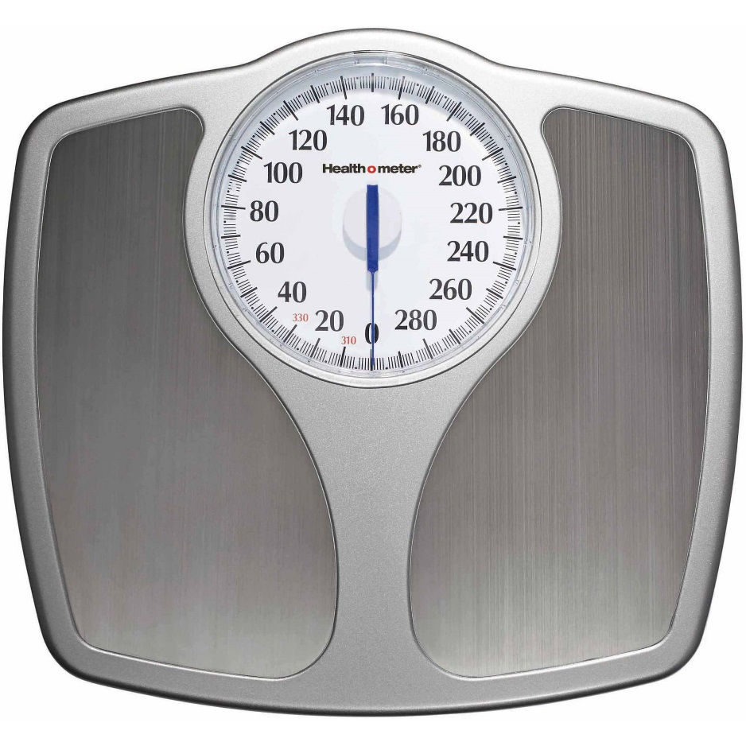
Weight Changes
Get in the habit of weighing yourself regularly. The scale will alert you to weight loss or gain.
If you are overweight, added pressure on the lungs make it even harder to breathe.
If you are underweight or lose weight unintendedly, the risk of COPD-related death doubles. ¹
Alert doctor with any weight changes.
Notes:
Make a note on overweight and lung function: - Another slide? Including COPD and Pulmonary Fibrosis details?
Lung.org - The best pulmonary fibrosis (PF) diet is the one that helps you maintain a healthy weight for your body and makes you feel the best.
People who are overweight or underweight have a harder time managing their PF.
If you are overweight, it can create more pressure on your lungs which can make it even harder to breathe. It also increases your risk for other diseases such as diabetes and heart disease.
If you are underweight, you may have less energy, which leads to weakening of the muscles that help with breathing. It can also put you at risk for diseases such as osteoporosis.
Nutrition Tips for PF
Eat a diet low in sodium (salt), added sugars, saturated and trans fat.
Try and get most of your calories from lean meats and fish, fruits, whole grains, beans, vegetables and low-fat dairy products.
If you are having a hard time gaining or maintaining your weight, try nutritional shakes or add healthy fats such as olive oil to your food.
If you have acid reflux, avoid acidic foods such as citrus, coffee and tomatoes. Do not eat within 3 hours of your bedtime. Talk with your doctor about medication that can help.
Eat smaller, more frequent meals to avoid getting too full, which can make it harder to breathe.
Drink lots of water, especially when you are exercising.
Some medications may have diarrhea as a side effect. Eating a bland diet, made up of bananas, rice, applesauce and toast (sometimes called the BRAT diet), can help. Always talk to your doctor about any side effects you are experiencing.
Ask for a referral to a registered dietitian who can give you specific pointers for managing your diet.

Slide 5
Malnutrition
Malnutrition and muscle wasting is a common problem in individuals with COPD:
30%-60% of patients in hospital setting
10%-45% in outpatient setting⁹
Why?
Robust inflammatory responses increase energy output
Low appetite and energy levels significantly reduce caloric intake and activity level.
Notes:
Malnutrition is a common problem in individuals with chronic obstructive pulmonary disease (COPD)⁴ with prevalence rates in inpatients of between 30% and 60% and in outpatients of between 10% and 45%. Malnourished COPD patients have greater gas trapping, lower diffusing capacity, and a lower exercise capacity when compared with heavier, non-malnourished patients with a similar severity of disease. Observational studies have shown that if nutritional assessment includes only body weight and unintentional weight loss, some patients with normal body weight for height (BMI) would go undetected despite being deplete of fat-free mass (FFM) (3, 4). A cross-sectional survey by Cano et al (3) in 300 outpatients with COPD requiring long-term oxygen therapy found that 17% of patients had a low BMI, whereas the prevalence of FFM depletion was >2-fold higher (38%). This accelerated loss of lean tissue, which may lead to sarcopenia and cachexia, is facilitated by robust inflammatory responses, which may also limit or prevent accretion of lean tissue after nutritional support (5). Wasting of muscles not only detrimentally affects respiratory function, including a reduced ability to expectorate to clear a chest infection, but also promotes fatigability and reduces exercise tolerance and the ability to work.
The majority of the patients with severe COPD are lean, and frequently in a malnourished or undernourished state, referred to as “pulmonary cachexia syndrome” (PCS), which is characterized by loss of fat-free body mass causing muscle wasting. In fact, it is estimated to occur in 25% to 40% of COPD patients and is associated with an accelerated decline in functional status, carrying an unfavorable prognosis.^{[5–7]} The muscle wasting in COPD not only leads to decreased skeletal muscle function associated with reduced exercise capacity, but is also a major determinant of mortality in COPD, independent of airflow obstruction.^{[8,9]}
EAL:
In people with COPD, the prevalence of malnutrition (as defined by a BMI less than 20kg/m²) may be as high as 30% and the risk of COPD-related death doubles with weight loss (Prescott et al, 2002; Chailleux et al, 2003; Ergun et al, 2003; Cochrane and Afolabi, 2004)
Even for the 70% with BMI greater than 20kg/m², body composition differs from healthy controls in that fat-free mass index and bone mineral density are lower in people with COPD (Engelen et al, 1999; De Benedetto et al, 2000; Karakas et al, 2005; Vestbo et al, 2006)
The total daily energy needs of people with COPD are highly variable due to differences in resting energy expenditure and in levels of physical activity (Hugli et al, 1996; Baarends et al, 1997; Creutzberg et al, 1998; Carter et al, 2003; Slinde et al, 2003)
In stable COPD and during an exacerbation, the presence of inflammation increases resting energy expenditure (Schols et al, 1996; Vermeeren et al, 1997; Nguyen et al, 1999; Schols et al, 1999; Creutzberg et al, 2000; Cohen et al, 2003; Calikoglu et al, 2004; Broekhuizen et al, 2006)

Slide 6
Malnutrition
Why is muscle wasting a problem?
Decreased respiratory function
Increased gas trapping, decreased diffusion, decreased ability to expectorate – clear lung infection
Decline in skeletal muscle function
Lower exercise capacity
Increased fatigability
Major determinant of mortality, independent of airflow obstruction^{9, 10}
Notes:
Malnutrition is a common problem in individuals with chronic obstructive pulmonary disease (COPD)⁴ with prevalence rates in inpatients of between 30% and 60% and in outpatients of between 10% and 45%. Malnourished COPD patients have greater gas trapping, lower diffusing capacity, and a lower exercise capacity when compared with heavier, non-malnourished patients with a similar severity of disease. Observational studies have shown that if nutritional assessment includes only body weight and unintentional weight loss, some patients with normal body weight for height (BMI) would go undetected despite being deplete of fat-free mass (FFM) (3, 4). A cross-sectional survey by Cano et al (3) in 300 outpatients with COPD requiring long-term oxygen therapy found that 17% of patients had a low BMI, whereas the prevalence of FFM depletion was >2-fold higher (38%). This accelerated loss of lean tissue, which may lead to sarcopenia and cachexia, is facilitated by robust inflammatory responses, which may also limit or prevent accretion of lean tissue after nutritional support (5). Wasting of muscles not only detrimentally affects respiratory function, including a reduced ability to expectorate to clear a chest infection, but also promotes fatigability and reduces exercise tolerance and the ability to work.
The majority of the patients with severe COPD are lean, and frequently in a malnourished or undernourished state, referred to as “pulmonary cachexia syndrome” (PCS), which is characterized by loss of fat-free body mass causing muscle wasting. In fact, it is estimated to occur in 25% to 40% of COPD patients and is associated with an accelerated decline in functional status, carrying an unfavorable prognosis.^{[5–7]} The muscle wasting in COPD not only leads to decreased skeletal muscle function associated with reduced exercise capacity, but is also a major determinant of mortality in COPD, independent of airflow obstruction.^{[8,9]}
Diffusing capacity of the lung measures the transfer of gas from air in the lung, to the red blood cells in lung blood vessels.
Gas trapping - In patients with COPD, the size of the lungs gets larger with disease progression as a result of gas trapping. Hyperinflation can worsen with rapid breathing such as during exercise. This happens because the diseased lungs are not as efficient as normal lungs at emptying air and air gets trapped in the lungs.

Slide 7
Building Blocks to Healthy Eating

Slide 8
Aim to make half of your plate fruits and vegetables
Fruits and vegetables provide the body with:
Soluble fiber
Antioxidants
Vitamins & minerals
Flavonoids

Slide 9
Avoid gas-producing fruits and vegetables.
A stomach swollen with gas can interfere with breathing.¹
These include:
Beans
Broccoli
Brussel sprouts
Cabbage
Corn
Cucumbers
Notes:
Carbonated beverages also increase the amount of gas that is trapped.
Also, eat slowly and don’t talk too much while you’re eating. You’ll swallow less air (EAL)

Slide 10
Aim to make a quarter of your plate whole grains
Whole grains provide the body with:
Dietary fiber
Complex carbohydrates
Vitamins & minerals
Notes:
Eat 20-30 grams of fiber each day from items such as bread, pasta, nuts, seeds, fruits, and vegetables. (lung.org)

Slide 11
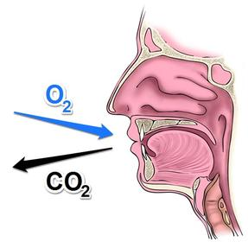
Metabolism: The process of turning food into fuel.
Carbohydrates we eat produce the most CO₂ while fats we eat produce the least.
For some people with COPD, eating a diet with fewer carbohydrates and more fat helps them breathe easier.⁷
Notes:
The process of changing food to fuel in the body is called metabolism. Oxygen and food are the raw materials of the process, and energy and carbon dioxide are the finished products. Carbon dioxide is a waste product that we exhale.
Metabolism of carbohydrates produces the most carbon dioxide for the amount of oxygen used; metabolism of fat produces the least. For some people with COPD, eating a diet with fewer carbohydrates and more fat helps them breathe easier. (lung.org)

Slide 12
Protein is an important part of a healthy diet as it helps repair body tissues and build respiratory muscles.
Choose a variety of heart-healthy proteins.
Heart-healthy protein options include:
Fish and shellfish
Poultry
Eggs
Beans
Soybeans
Nuts
Quinoa
Seeds
Notes:
Examples
Beans – hummus
Soybeans – Tofu, tempeh, soy yogurt, edamame
Nuts – includes nut butters
Quinoa – as well as other grains such as amaranth, spelt, millet, sorghum, buckwheat, teff

Slide 13
Healthy fats are necessary for the heart and keep the body running smoothly.
Types of dietary fat:
Monounsaturated fats
Polyunsaturated fats
Saturated fats
Trans fats
HIGHER
LOWER
Notes:
Unsaturated fat is the types of fat that is liquid at room temperature and comes mostly from plant sources. Eating foods high in unsaturated fats may help lower LDL cholesterol.

Slide 14
Monounsaturated fat
Sources:
Olive, canola, and peanut oils
Olives and avocados
Nuts and nut butters
Polyunsaturated fat
Sources:
Fatty fish
Seeds (sunflower, sesame, flax, chia, pumpkin)
Walnuts, pine nuts, tahini
Vegetable oils
HIGHER
LOWER
Notes:
Unsaturated fat is the types of fat that is liquid at room temperature and comes mostly from plant sources. Eating foods high in unsaturated fats may help lower LDL cholesterol.
Registered Dietitians should encourage individuals with COPD to consume a diet that meets the Adequate Intake (AI) for omega-3 fatty acids. Adequately powered studies have not been conducted to evaluate the effects of intake above the AI. One randomized trial reports improvements in subjects with COPD after consuming an omega-3 fatty acid-rich supplement (Matsuyama et al, 2005).

Slide 15
Saturated fat
Found mainly from animal sources, although some plants also contain saturated fat.
Saturated fats raise total cholesterol and have been associated with increased inflammation in the body.
Eat in limited amounts.
Sources:
Fatty meat cuts
Hamburger
Bacon, sausage
Lunch meat
Skin of poultry
Butter, cream, cheese
Gravies
Coconut, palm oil
HIGHER
LOWER
Notes:
In stable COPD and during an exacerbation, the presence of inflammation increases resting energy expenditure (Schols et al, 1996; Vermeeren et al, 1997; Nguyen et al, 1999; Schols et al, 1999; Creutzberg et al, 2000; Cohen et al, 2003; Calikoglu et al, 2004; Broekhuizen et al, 2006) (EAL)

Slide 16
Trans fat:
Keep trans fats as low as possible (<1% of total energy)
A 2% absolute increase in energy intake from trans fat has been associated with a 23% increase in cardiovascular risk.⁵
Common sources:
HIGHER
LOWER
Margarines
Vegetable shortening
Packaged snacks (chips crackers, cookies)
Baked items (cakes, donuts, pastries, pies, biscuits)
Microwave theater popcorn
All deep-fried foods
Notes:
0.5 grams or less are not required to be indicated on nutrition facts label. As stated, even a small amount can be very detrimental

Slide 17
On milk and mucous:
A growing body of evidence suggests that milk and milk products do not affect mucous production or lung function parameters, however, more research is needed.¹
Limiting milk and milk products can result in low intakes of many nutrients, including Calcium and Vitamin D.
Notes:
Registered dietitians should advise individuals with COPD that the consumption of milk and milk products is unrelated to mucus production. Studies report no significant effect of milk and milk product consumption on mucus production or various lung function parameters, despite individual sensory perception.
Authors of a narrative review published in 2005, of 49 references, concluded that while some people may perceive some aspects of mucus production after consuming milk and milk products (either cow's or soy), there is no significant effect of milk and milk product consumption on mucus production or various lung function parameters (Wuthrich et al, 2005)
Further research on milk and milk product consumption on mucus production in people with COPD is needed.
Limiting milk and milk product consumption can lead to low intakes of many nutrients, including calcium.
research reports that consumption of milk does not significantly change various lung function parameters
people who believe that milk increases mucus formation are more likely to report changes in sensory perceptions related to mucus after drinking milk than those who do not hold the same belief
symptoms of increased mucus formation were detected after consumption of both cow's milk and a soy beverage with similar sensory properties
persons who were convinced of mucus formation due to milk consumption showed more respiratory symptoms; this may be partially explained by the aggregation after mixing of an emulsion such as milk with saliva
*Taken from EAL

Slide 18
Bone Health:
An estimated 25-60% of people with COPD develop osteoporosis or vertebral fractures.
Lower body weight is associated with decreased bone mineral density.¹
Notes:
People with COPD are at increased risk for osteoporosis and vertebral fractures and the prevalence ranges from 25% to 60% (Szymanski et al, 2002; Papaioannou et al, 2003; Soriano et al, 2005)
Four studies support a positive correlation between low body weight or BMI with decreased bone mineral density in subjects with COPD (Nishimura et al, 1997; Incalzi et al, 2000; Katsura and Kida, 2002; Bolton et al, 2004)
Additional risk factors reported include older age, smoking and corticosteroid use (Yeh et al, 2002; Melton et al, 2004; de Vries et al, 2005)
Emerging research reports associations between hypercapnia, vitamin D status and bone mineral density (Dimai et al, 2001; Karadag et al, 2003; Forli et al, 2004). Further research is needed in these areas.
For individuals with COPD who have osteopenia or osteoporosis, registered dietitians should encourage consumption of adequate amounts of calcium and vitamin D, as well as avoidance of tobacco smoking and excessive alcohol intake, as determined by national treatment guidelines for osteoporosis. Osteopenia and osteoporosis guidelines specific to individuals with COPD have not yet been determined.
Synopsis of Major Recommendations to the Clinician: Advise on adequate amounts of calcium (at least 1, 200mg per day, including supplements, if necessary) and vitamin D (800 IU to 1, 000 IU per day of vitamin D₃for individuals at risk of insufficiency).
Advise avoidance of tobacco smoking and excessive alcohol intake
Initiate therapy in those with BMD T-scores up to -2.5 at the femoral neck, total hip or spine by DXA, after appropriate evaluation.

Slide 19
Factors that weaken bones:
Older age
Corticosteroids
Hypercapnia
Smoking
Excessive alcohol
Lack of exercise
Low Vitamin D
Low Calcium
For Bone Health: Aim for at least 1,200 mg Calcium and 800-1000 IU Vitamin D each day¹
Notes:
There are many factors unlisted that can affect bones, these are most pertinent to COPD.
Often, people with COPD take steroids. Long-term use of steroids may increase your need for calcium. Consider taking calcium supplements. Look for one that includes vitamin D. Calcium carbonate or calcium citrate are good sources of calcium. (lung.org)
Hypercapnia, or hypercarbia, is when you have too much carbon dioxide (CO₂) in your bloodstream. It usually happens as a result of hypoventilation, or not being able to breathe properly and get oxygen into your lungs.
People with COPD are at increased risk for osteoporosis and vertebral fractures and the prevalence ranges from 25% to 60% (Szymanski et al, 2002; Papaioannou et al, 2003; Soriano et al, 2005)
Four studies support a positive correlation between low body weight or BMI with decreased bone mineral density in subjects with COPD (Nishimura et al, 1997; Incalzi et al, 2000; Katsura and Kida, 2002; Bolton et al, 2004)
Additional risk factors reported include older age, smoking and corticosteroid use (Yeh et al, 2002; Melton et al, 2004; de Vries et al, 2005)
Emerging research reports associations between hypercapnia, vitamin D status and bone mineral density (Dimai et al, 2001; Karadag et al, 2003; Forli et al, 2004). Further research is needed in these areas.
For individuals with COPD who have osteopenia or osteoporosis, registered dietitians should encourage consumption of adequate amounts of calcium and vitamin D, as well as avoidance of tobacco smoking and excessive alcohol intake, as determined by national treatment guidelines for osteoporosis. Osteopenia and osteoporosis guidelines specific to individuals with COPD have not yet been determined.
Synopsis of Major Recommendations to the Clinician: Advise on adequate amounts of calcium (at least 1, 200mg per day, including supplements, if necessary) and vitamin D (800 IU to 1, 000 IU per day of vitamin D₃for individuals at risk of insufficiency).
Advise avoidance of tobacco smoking and excessive alcohol intake
Initiate therapy in those with BMD T-scores up to -2.5 at the femoral neck, total hip or spine by DXA, after appropriate evaluation.

Slide 20
Sodium (salt): 2300 mg per day or less.
Added sugar: Avoid foods and drinks with added sugar, except the occasional treat.
Alcohol: If you don’t drink, don’t start. If you do, keep it light.
Tips:
Get plenty of fluids
Check nutrition labels
Use herbs and spices to flavor foods
Notes:
Get plenty of fluids
Fluids help thin mucus and keep your airways more clear. Drink 8 glasses of water every day, and choose soups and broths often. (Try to take your fluids between meals, so they won’t interfere with your appetite at mealtimes.) Limit your caffeine intake, though — it can make you nervous and may interfere with some of your medications.
Keep your salt intake to 2,400 mg a day or less. Salt makes you retain fluids, which can make breathing harder. (lung.org)
COPD and HTN
As you may have guessed, COPD takes a significant toll upon the body. Breathlessness, weight loss, sleeping and eating problems, and a depletion in energy are just some of the effects that the disease can cause for a person. COPD can also affect the workings of the heart. The nature of the disease forces the heart to work overtime.
Since the lungs are damaged, the amount of oxygen that goes to the blood is reduced. This produces high blood pressure in the blood vessels from the heart to the lungs, and makes it even more difficult for the heart to pump much-needed blood to the rest of the body. This lung disease can also cause the body to produce more red blood cells, which can make the blood thicker and harder to pump. The COPD and hypertension working together forces the person to breathe faster in order to take in more oxygen.

Slide 21
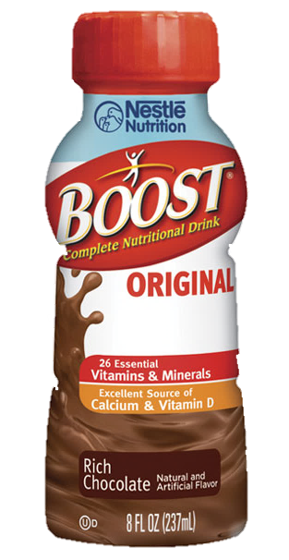
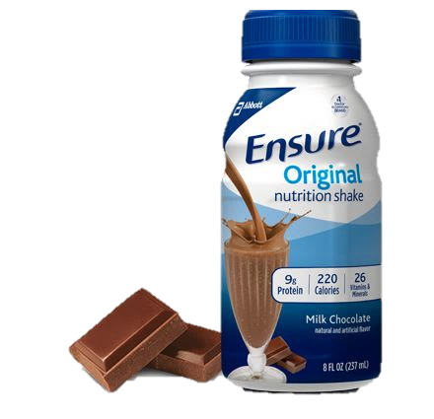
Medical Nutrition Supplements
Why?
Increase calorie intake
More weight gain when combined with exercise¹
Provide vitamins & minerals of concern
Effective with poor appetite and energy levels
Notes:
Registered dietitians should encourage individuals with COPD to consume a diet that meets the Recommended Dietary Allowances (RDA) for vitamin A, vitamin C and vitamin E. Several studies report reduced serum or tissue levels of vitamin A, vitamin C and vitamin E in individuals with COPD, however adequately powered studies have not been conducted to evaluate the effects of intake above the RDA.
For the recommendation on COPD: Medical Food Supplements for Outpatients:
In the outpatient setting, nutritional supplementation results in increased energy intake, with weight gain more likely when combined with exercise (Schols et al, 1995; Akrabawi et al, 1996; Schols et al, 1998; Vermeeren et al, 2001; Cai et al, 2003; Creutzberg et al, 2003; Broekhuizen et al, 2005; Planas et al, 2005)
Registered dietitians should advise that the selection of medical food supplements for individuals with COPD should be influenced more by patient preference than the percentage of fat or carbohydrate. There is limited evidence to support consumption of a particular macronutrient composition of medical food supplementation.

Slide 22
Poor Appetite
Low Energy
Eat 4-6 small meals a day
Limit liquids with meals
Eat more in the morning if you’re usually too tired to eat later in the day
Drink nutrition supplement at night to avoid feeling full during the day⁷
Medication to stimulate appetite may be recommended⁴
Plan and prepare meals ahead
Choose foods that are easy to prepare⁷
Use small appliances that make cooking easier
Ask for help
Eat slowly, chew food well⁶
Use supplemental oxygen as prescribed¹
Notes:
If you continue to lose weight, a prescription medication may be recommended to stimulate your appetite
https://www.uptodate.com/contents/chronic-obstructive-pulmonary-disease-copd-treatments-beyond-the-basics
Eat slowly, and chew food well Plan and prepare meals ahead Use small appliances that make cooking easier (microwave, slow cooker, rice cooker, electric steamer, bread maker, etc.) Eat 6 small meals a day (IHC Fact Sheet Energy Conservation Plan)
Studies report that supplemental oxygen improves the ability of individuals with COPD to perform activities of daily living and exercise.
Authors of a Cochrane review published in 2005, of 31 studies concluded that ambulatory oxygen, defined as the use of supplemental oxygen during exercise and the activities of daily living, improves exercise performance in people with moderate to severe COPD (Bradley and O'Neill, 2005)
Rest just before eating.
Eat more food early in the morning if you're usually too tired to eat later in the day.
Avoid foods that cause gas or bloating. They tend to make breathing more difficult.
Eat 4 to 6 small meals a day. This enables your diaphragm to move freely and lets your lungs fill with air and empty out more easily
If drinking liquids with meals makes you feel too full to eat, limit liquids with meals; drink an hour after meals.
Consider adding a nutritional supplement at night time to avoid feeling full during the day
offer to help your loved one with grocery shopping or cooking. Choose foods that are easy to prepare. If you use all your energy to cook, you won't have enough left to eat.(lung.org)

Slide 23
Power Packing
Power packing is a way to add calories and protein to foods without adding volume
Use more cooking oil or heart-healthy spread on toast, sandwiches, eggs, vegetables
Spread nut butters generously on bread, pancakes, fruit, oatmeal, or crackers
Spread hummus on crackers, top beans with sour cream, canola oil or cheese
Add 2 T of powdered milk to recipes that use milk
Add meat to sandwiches, salads, or soups (shred or chop for easier chewing)
Add avocado or guacamole to sandwiches, burgers, omelets, toast, or use as dip
Top dishes with extra gravy, sauces, dressing, nuts, seeds, granola, cheese

Slide 24
Meal Examples
Breakfast
Whole grain unsweetened cereal with whole milk topped with berries or banana
Omelet with veggies, cheese, meat and whole grain toast
Oatmeal with peanut butter and fruit
Yogurt with fruit and granola
Hard-boiled egg, cheese stick and an apple
Smoothies

Slide 25
Meal Examples
Lunch and Dinner
Sandwich, wrap, or salad
Grilled chicken with roasted vegetables and rice
Grilled salmon and wild rice
Spaghetti with tomato sauce, chicken, and vegetables
Enchiladas with vegetables, cheese, and chicken

Slide 26
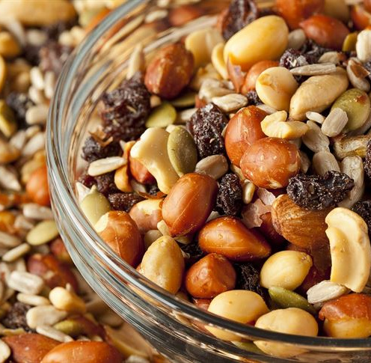
Meal Examples
Snacks
Sliced fruits or vegetables
Nuts: almonds, walnuts, peanut butter
Popcorn
Yogurt: light
String cheese
Whole grain cereal, muffins, crackers, granola bars, or chips

Slide 27
References
Academy of Nutrition and Dietetics Evidence Analysis Library. “COPD: Major Recommendations (2008)" Accessed 1 May 2018: https://www.andeal.org/topic.cfm?menu=5301&cat=3710
Choose MyPlate. Retrieved from http://www.choosemyplate.gov/
Dietary Guidelines for Americans 2015–2020 8th Edition. Retrieved from https://health.gov/dietaryguidelines/2015/guidelines/.
Han, M. K. (2018, May 17). Patient education: Chronic obstructive pulmonary disease (COPD) treatments (Beyond the Basics). Retrieved May 23, 2018, from https://www.uptodate.com/contents/chronic-obstructive-pulmonary-disease-copd-treatments-beyond-the-basics
Mozaffarian D, Katan MB, Ascherio A, Stampfer MJ, Willett WC. Trans fatty acids and cardiovascular disease. N Engl J Med. 2006; 354:1601-1613
My Energy Conservation Plan. Homecare Series; Intermountain Healthcare (2015)
Nutrition and COPD. Retrieved May 1, 2018, from http://www.lung.org/lung-health-and-diseases/lung-disease-lookup/copd/living-with-copd/nutrition.html
Nutrition for a Healthy Heart. Live Well; Intermountain Healthcare and Select Health(2018)
Peter F Collins, Rebecca J Stratton, Marinos Elia; Nutritional support in chronic obstructive pulmonary disease: a systematic review and meta-analysis, The American Journal of Clinical Nutrition, Volume 95, Issue 6, 1 June 2012, Pages 1385–1395, https://doi.org/10.3945/ajcn.111.023499 https://academic.oup.com/ajcn/article/95/6/1385/4568385
Rawal G, Yadav S. Nutrition in chronic obstructive pulmonary disease: A review. Grouse L, ed. Journal of Translational Internal Medicine. 2015;3(4):151-154. doi:10.1515/jtim-2015-0021. https://www.ncbi.nlm.nih.gov/pmc/articles/PMC4936454/
8 to Live By: Healthy Habits for Kids, Teens, and Families. Live Well; Intermountain Healthcare (2015)

