Slide 1
Updating Your Beneficiary and Emergency Contact in Oracle Cloud ERP
Benefits Module

Slide 2
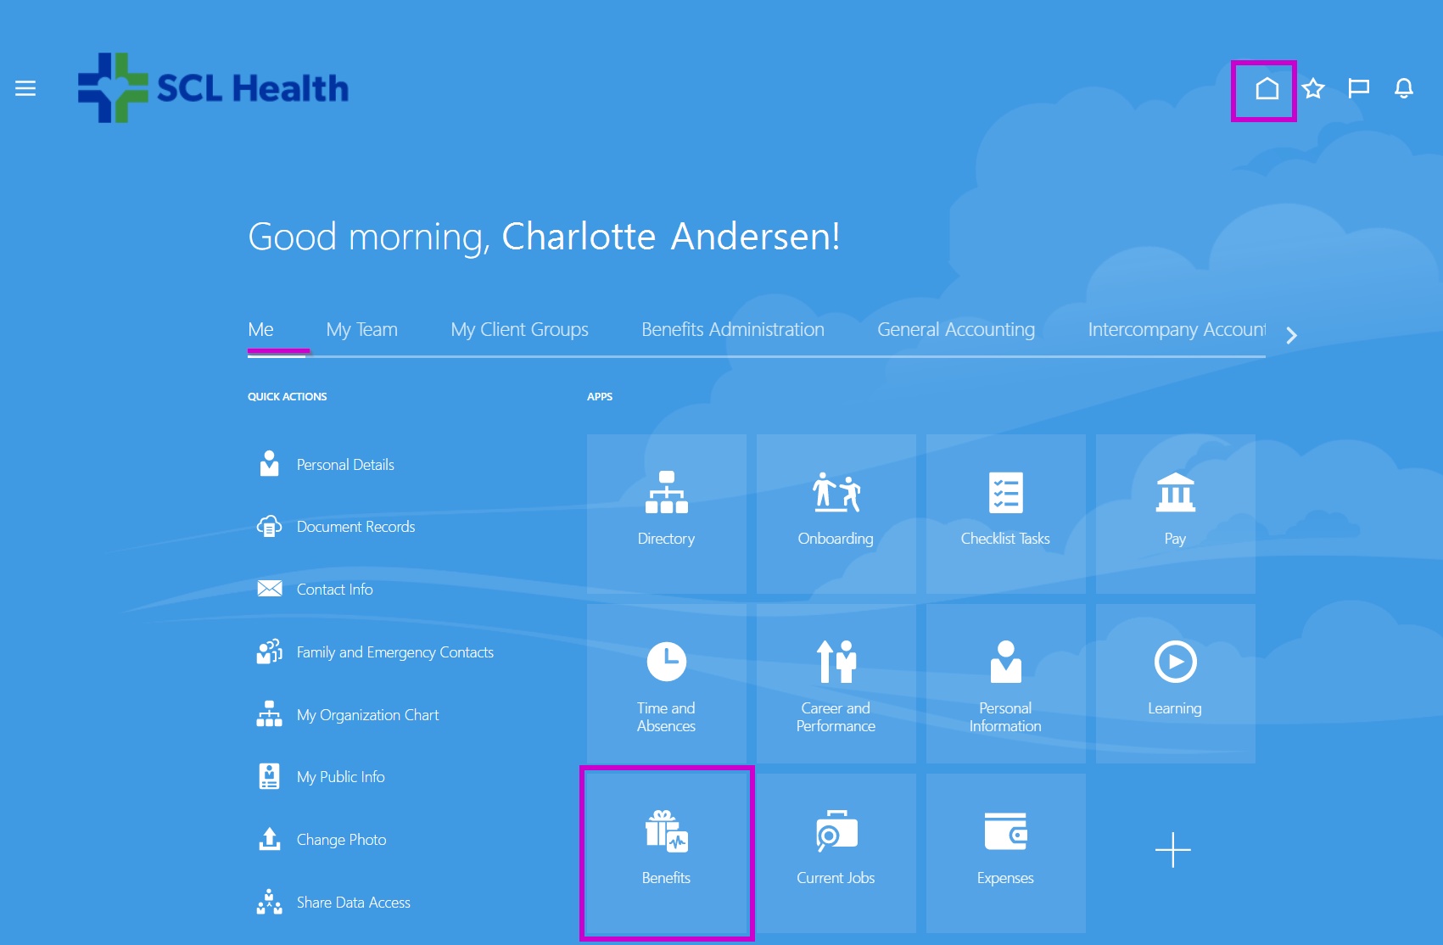
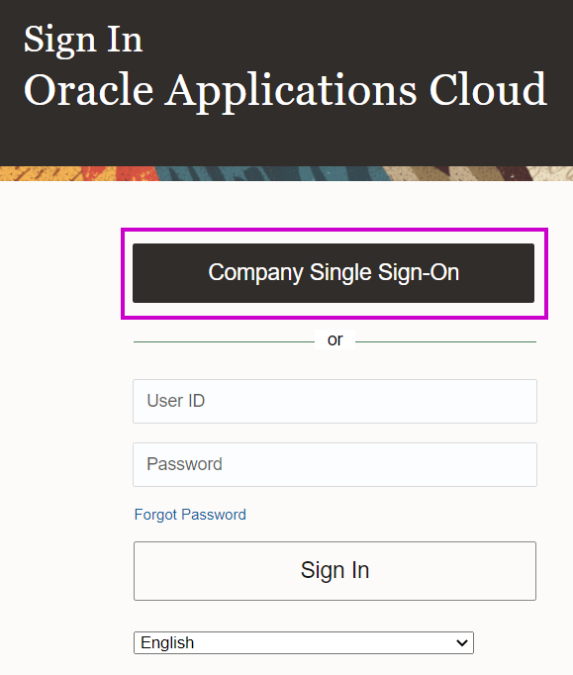
Adding Your Beneficiaries & Emergency Contacts
Navigate to Oracle ERP Cloud on The Landing
Click Company Single Sign-on
Click the Home icon in the upper-right menu
Click the Benefits tile

Slide 3
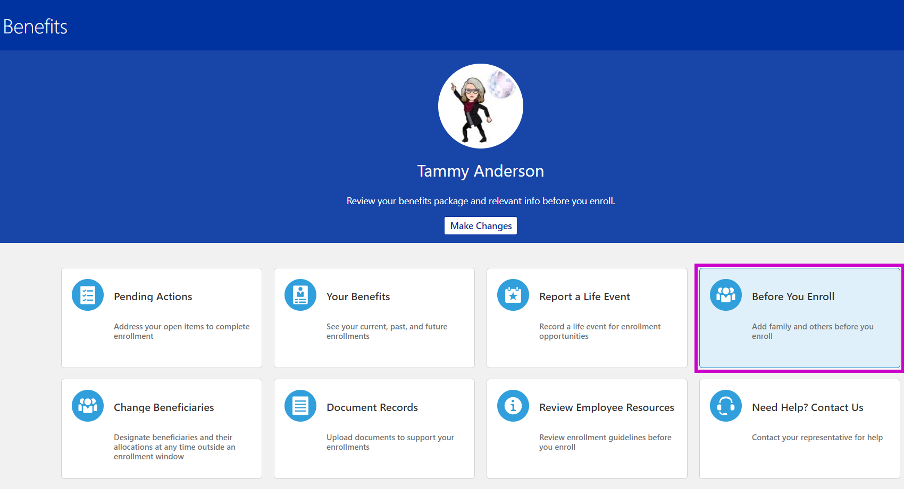
Adding Your Beneficiaries & Emergency Contacts
Click on Before You Enroll

Slide 4
Adding Your Beneficiaries & Emergency Contacts
If you are covering dependents on your benefits, they will already be listed here
If those listed are who you want to designate as your beneficiary(ies), skip to page 7
To edit an existing contact, click their name
For example, if you want to make someone your Emergency Contact
Click + Add to add a new person or organization (such as a trust or charity)

Slide 5
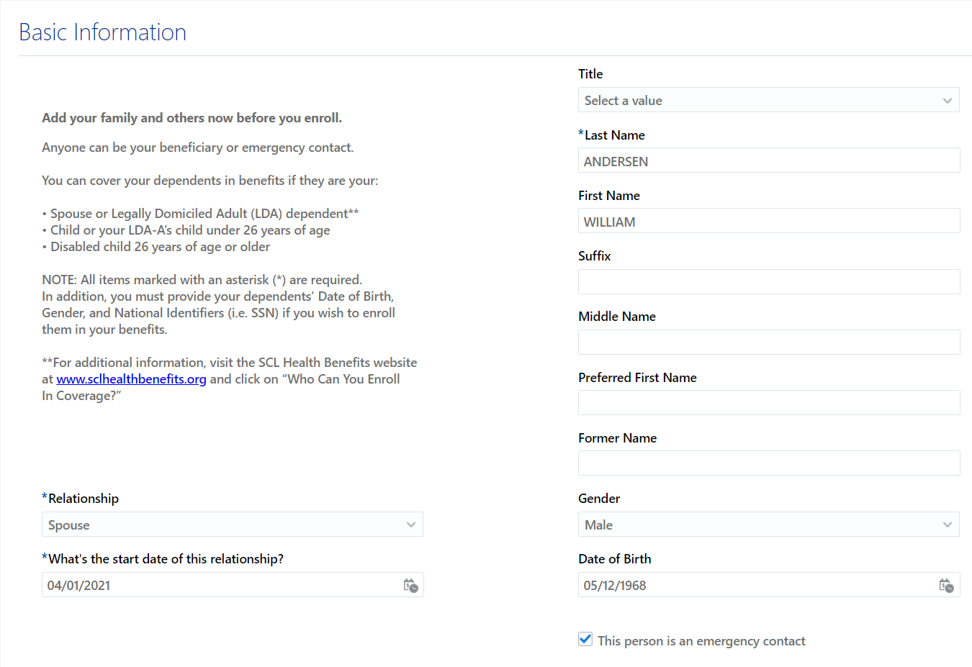
Adding Your Beneficiaries & Emergency Contacts
Enter all required information for each contact. All items marked with an asterisk (*) are required.
Important:
Anyone can be your beneficiary or emergency contact.
Select the Emergency Contact box, when appropriate.
Date of birth, gender, and National Identifier (e.g., SSN) are required for benefit-eligible relationships (i.e. spouse, child, LDA).
Use both the area code and number fields to enter a 10-digit phone number.
Relationship start date must be a date in the past (e.g., marriage date, birth date, etc.)
Address must be typed and drop-down boxes used. Do not select a pre-fill option or you may need to cancel and start over.
When done, click Submit at the top of the page.

Slide 6
Adding Your Beneficiaries & Emergency Contacts
Once you have verified and/or added all your contacts, click Continue.

Slide 7
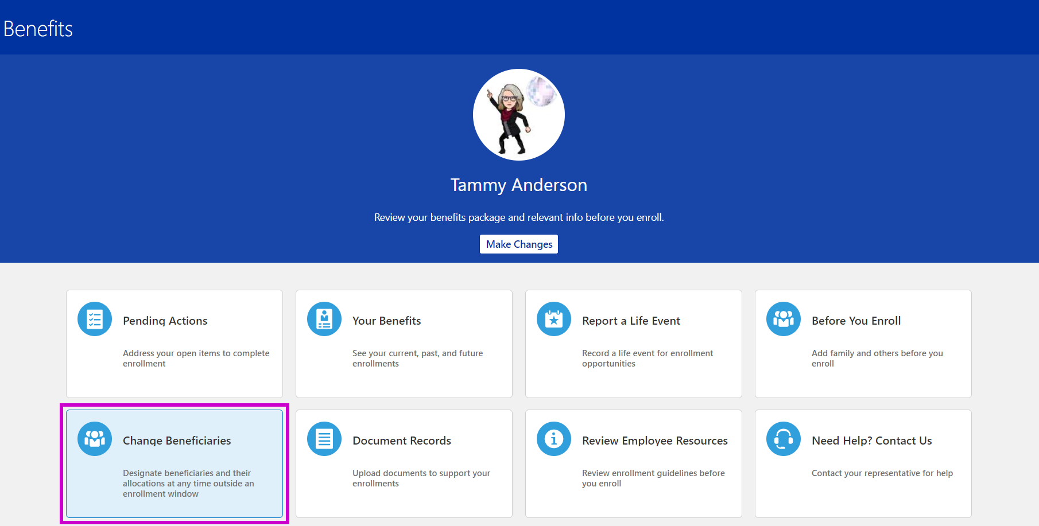
Updating Your Beneficiaries
Now that your beneficiaries have been added…
Click the Home icon in the upper-right menu
Click the Benefits tile
Click on Change Beneficiaries

Slide 8
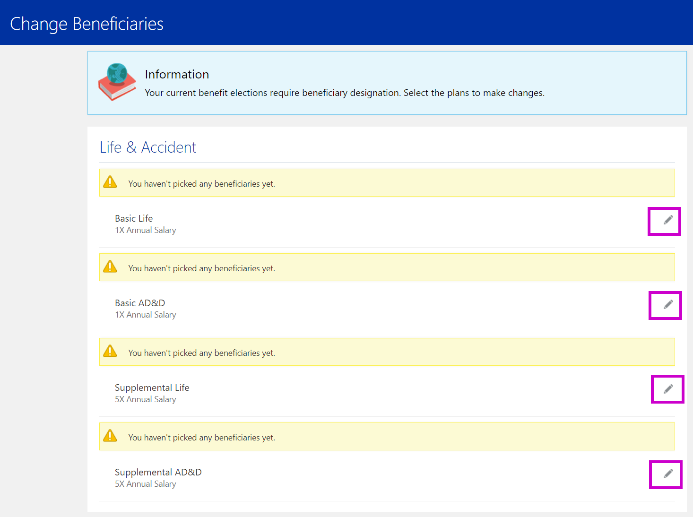
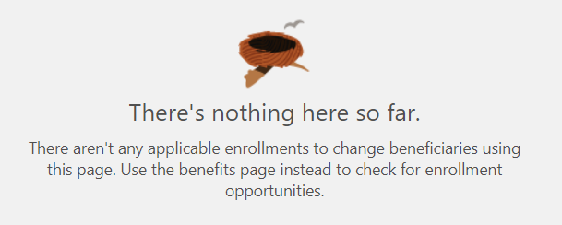
Updating Your Beneficiaries
For each of your Life & Accident plans, click the grey edit pencil to open the record for that plan.
NOTE: If you see a blank page, like this:
It means you have an enrollment opportunity open (like a new hire or qualifying life event). Use these instructions instead to enroll and update your beneficiaries through that process.

Slide 9
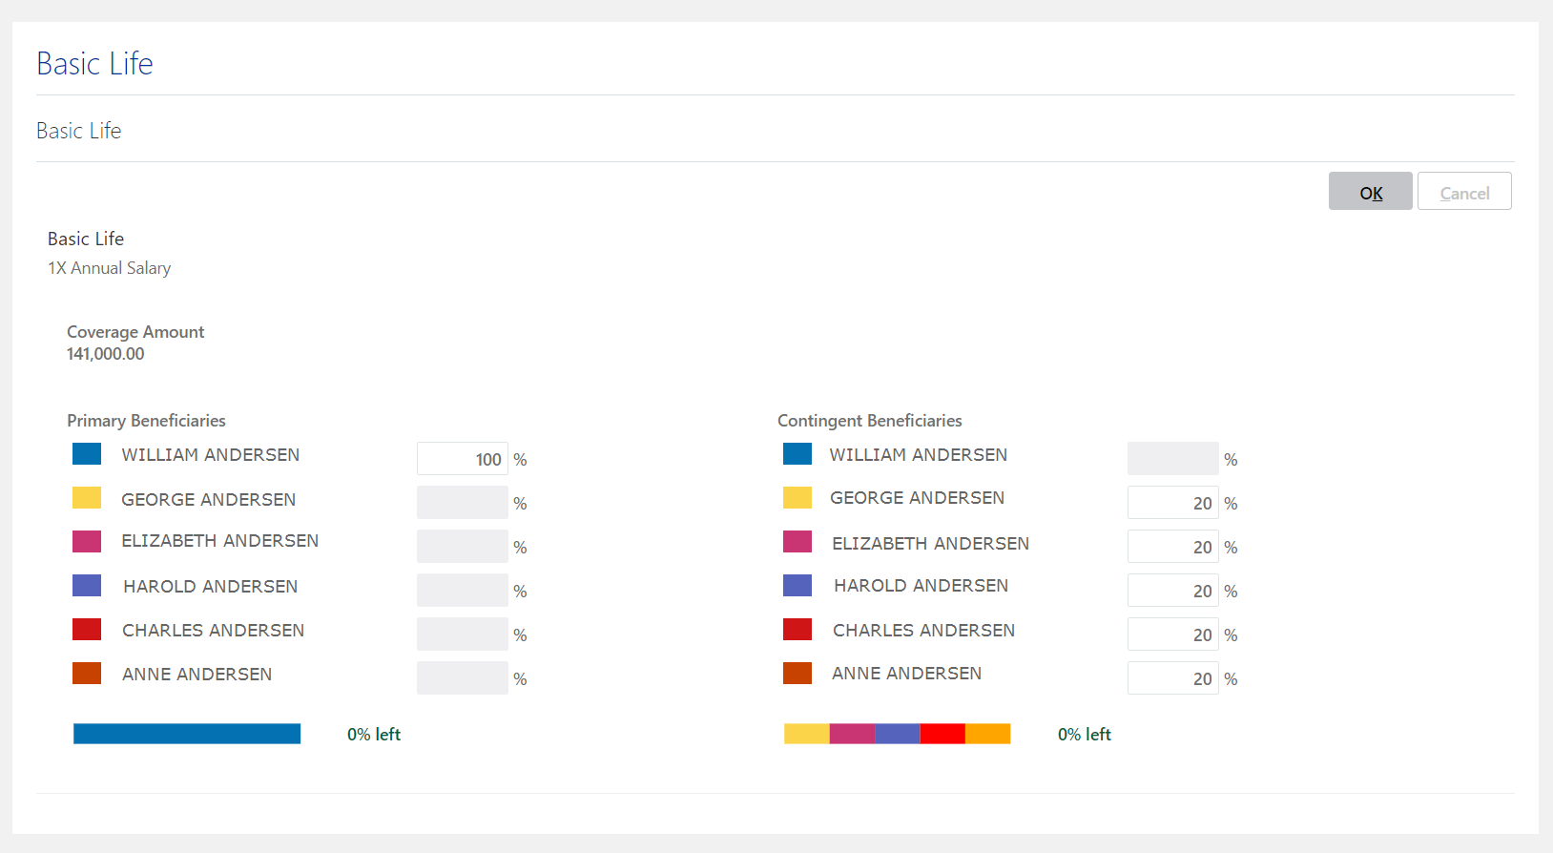
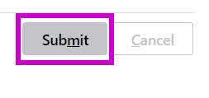
Updating Your Beneficiaries
Select your Primary and Contingent beneficiaries.
Your primary beneficiary is the person or entity who has the first claim to inherit your assets if you pass. A contingent beneficiary is basically just your back up beneficiary.
For each one, select the percentage of the proceeds you want each to receive.
The total for each must equal 100%.
When you’re done, click Submit.
50,000.00

Slide 10
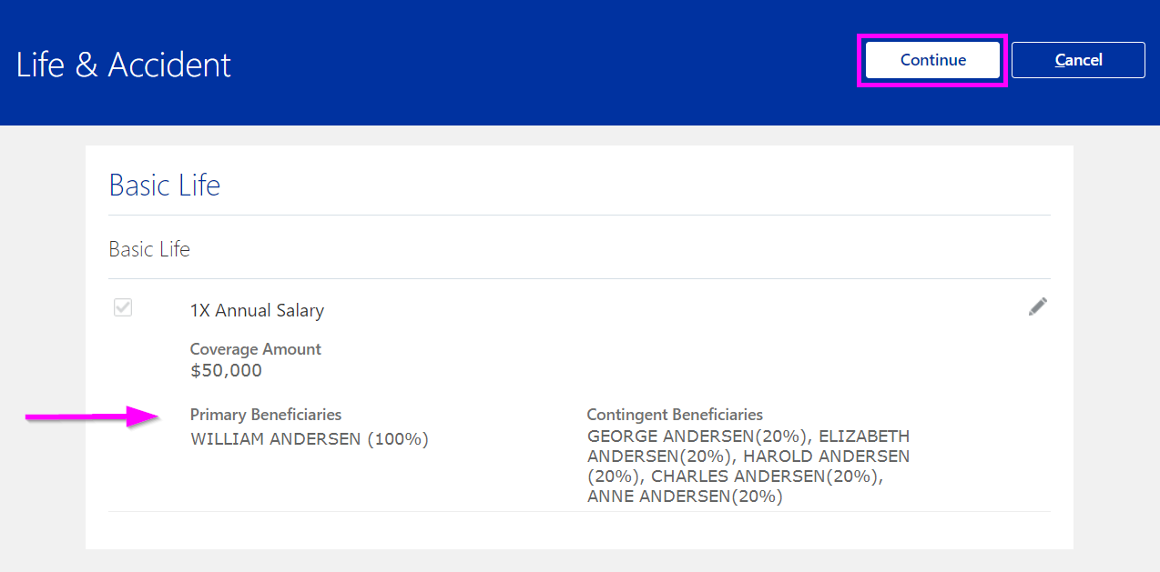
Updating Your Beneficiaries
After you’ve selected your beneficiaries for each Life and AD&D plan, you will see them listed within the info box for that plan.
Once you’ve finished designating your primary and contingent beneficiaries for all Life & Accident plans, you’re done!
NOTE: You are automatically the beneficiary for any spouse/LDA-A and child plans you elected. You need only select beneficiaries for plans that cover you.

Slide 11
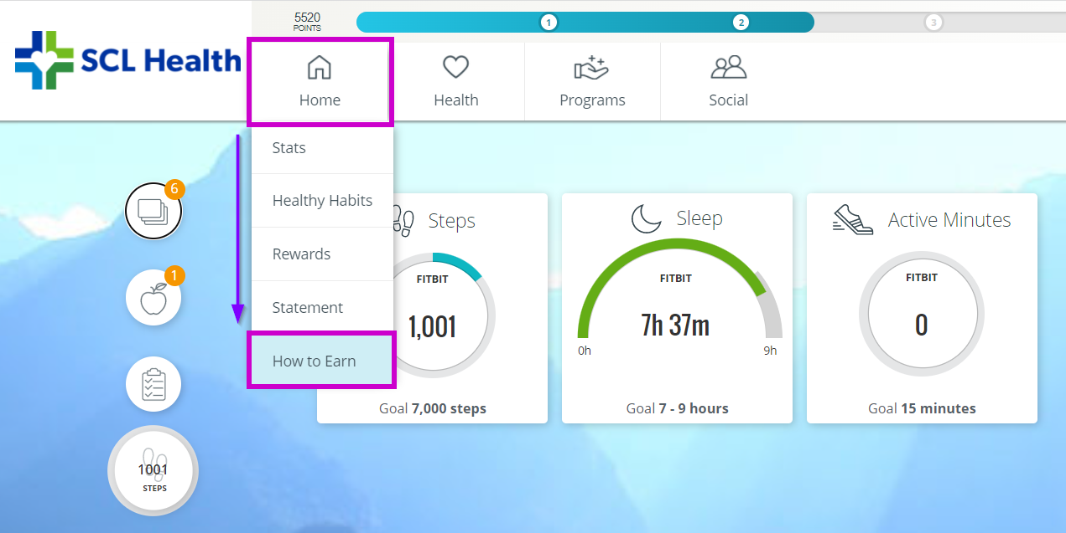
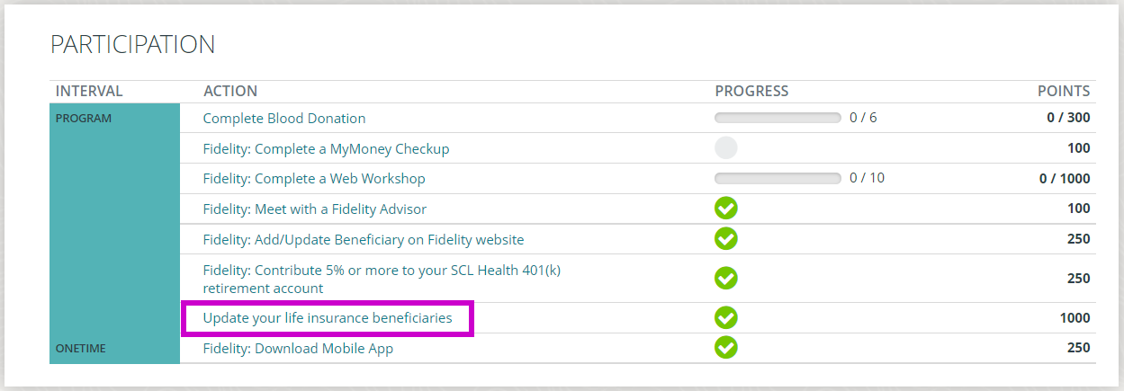
Earning Points Through Virgin Pulse
In 2021, you can earn 1,000 points after you update your beneficiaries in Oracle. Here’s how to get them:
Login to your Virgin Pulse account: member.virginpulse.com
Hover over Home
Click How to Earn
Scroll down to PARTICIPATION and click on Update your life insurance beneficiaries
Read through the attestation. If true, click the box. Click Submit.
It’s that easy!

